Slide 1
Introduction to Machine Learning and Deep Leaning

Slide 2
Before Machine Learning

Slide 3
Models, models, models “experimental data”
We build models all the time. What are the models ?
Why models are important ?
What do models give us as scientists and engineers ?

Slide 4






Need to select the capacity of the circuit breaker.

Slide 5
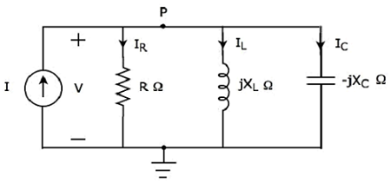
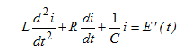
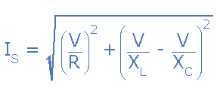
The classical approach
Step 2: Build the electric model.
Step 3: find The mathematical model and use it.

Slide 6
What is Machine Learning ?
Traditional programming vs Machine learning.

Slide 7
How would ML solve the previous problem ?
Traditional programming vs Machine learning.

Slide 8
The main steps of Machine Learning
Feature extraction.
Model selection.
Optimization.
Using the model.

Slide 9
What are the features? Why are they important ?
Back to modelling ? How do we get features ?

Slide 10
Underfitting Vs Overfitting
BBBBut why overfitting is bad ? It doesn’t make sense.
The sweetspot.

Slide 11
Case study: Snake Classification

Slide 12
Deep Learning

Slide 14
The most Important take away
All models are WRONG but some are USEFUL.
Garbage in Garbage out !

